Slide 1

Powering Up The Shell
Powering up the Shell for PowerShell, aka ShellPower

Slide 2
Get-Help -Category “Shell Customization”
Agenda
PowerShell Prompts
PowerShell Profiles
Third Party Shells
Extensions and Tools (Things I Use)
Homework
That’s right, you had homework!

Slide 3
function Prompt { return “PS THIS > “ }

Slide 4
$profile Loading Order
Local Machine All Hosts
Local Machine Current Host
Current User All Hosts
Current User Current Host

Slide 5
What are some things you may put into your profile?

Slide 6
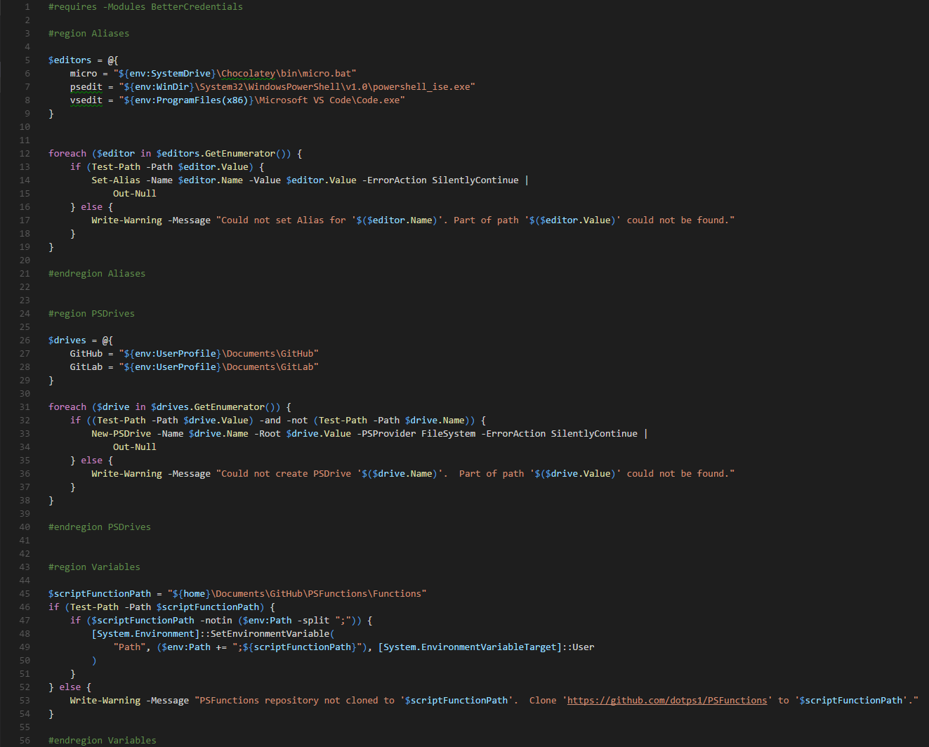

Slide 7
Extensions and Tools
PSGit | https://github.com/PoshCode/PSGit
PowerLine | https://github.com/Jaykul/PowerLine
BetterCredentials | https://github.com/Jaykul/BetterCredentials
ConEmu | https://github.com/Maximus5/ConEmu
Micro | https://github.com/zyedidia/micro
Git | https://github.com/git-for-windows/git-for-windows.github.io

Slide 8
Get-ContactInformation -Name dotps1 -All
Blog | https://dotps1.github.io
PSUG | https://grposh.github.io
GitHub | https://github.com/dotps1
Twitter | @dotps1
Email | dotps1@outlook.com
Phone | 616-867-5309

